Slide 1
Evalution of CRICKET
From Local Pastime to Global Phenomenon

Slide 2
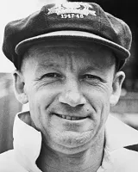
Legendary Cricketers : Icons of the Game
Widely regarded as the greatest batsman in cricket history, Bradman had an astonishing Test batting average of 99.94, scoring 29 Test centuries.
Sir Don Bradman

Slide 3
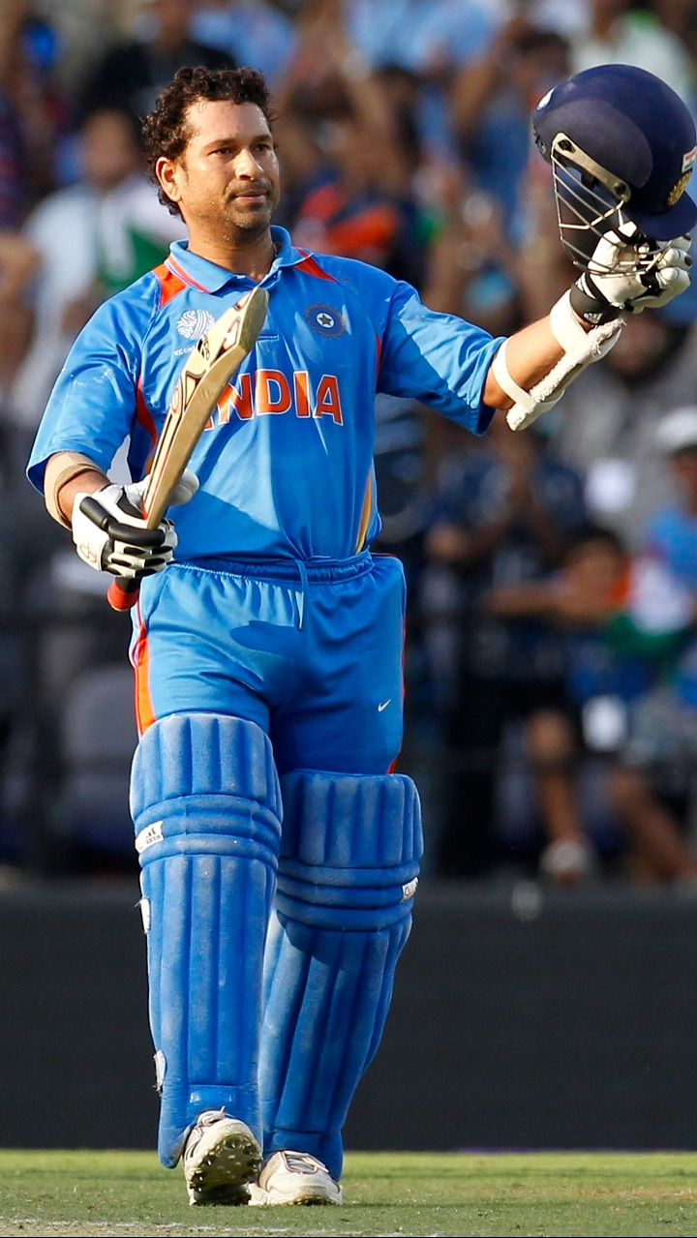
Legendary Cricketers : Icons of the Game
Known as the "Master Blaster," holds numerous records, including most international runs (34,357) and centuries (100).
Sachin Tendulkar

Slide 4
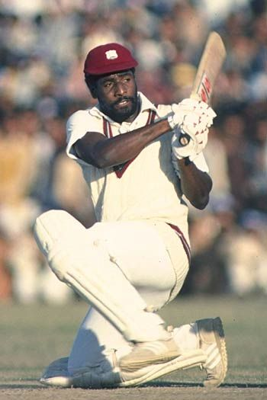
Legendary Cricketers : Icons of the Game
A formidable West Indian batsman, amassed over 8,500 Test runs at an average of 50.23, including 24 centuries.
Sir Vivian Richards

Slide 5
The Impact of Cricket on Society
Building Communities
Promoting Unity and Diversity
National Pride
Examples of Positive Influence

